Slide 1

The Legend of Zelda Database
Sarah Nicholson

Slide 2
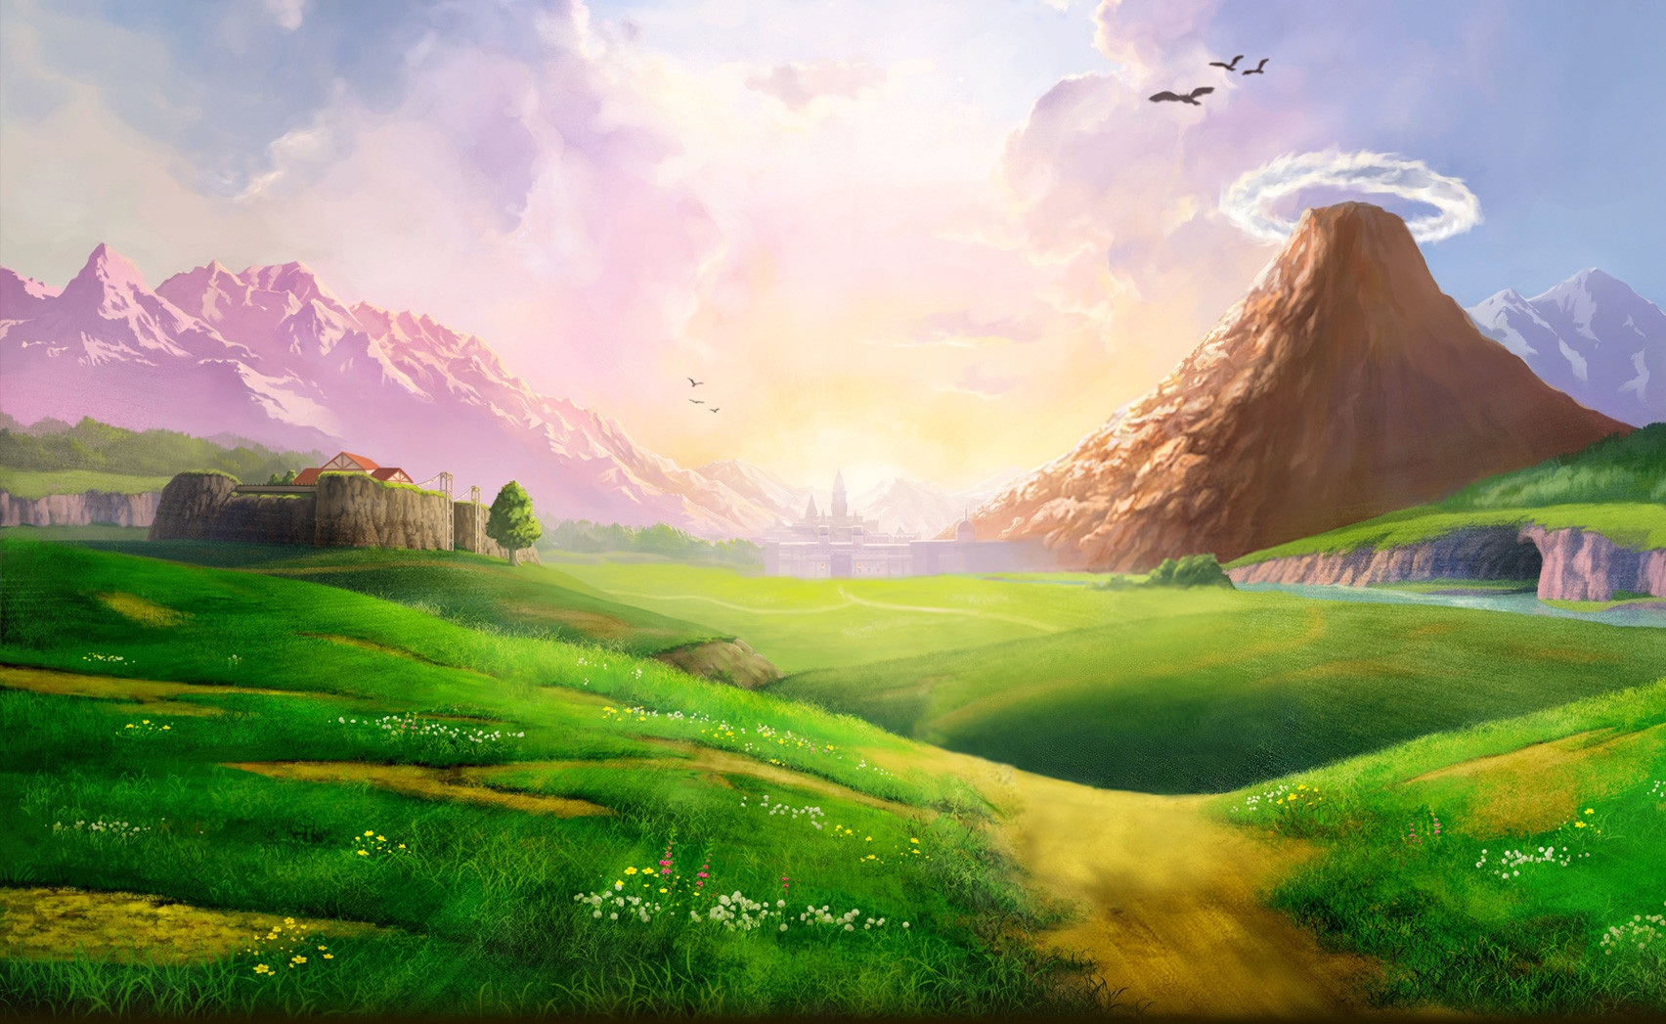
Tables
Main Series Games
Characters
Bosses
Enemies
Locations
Races
Items

Slide 3
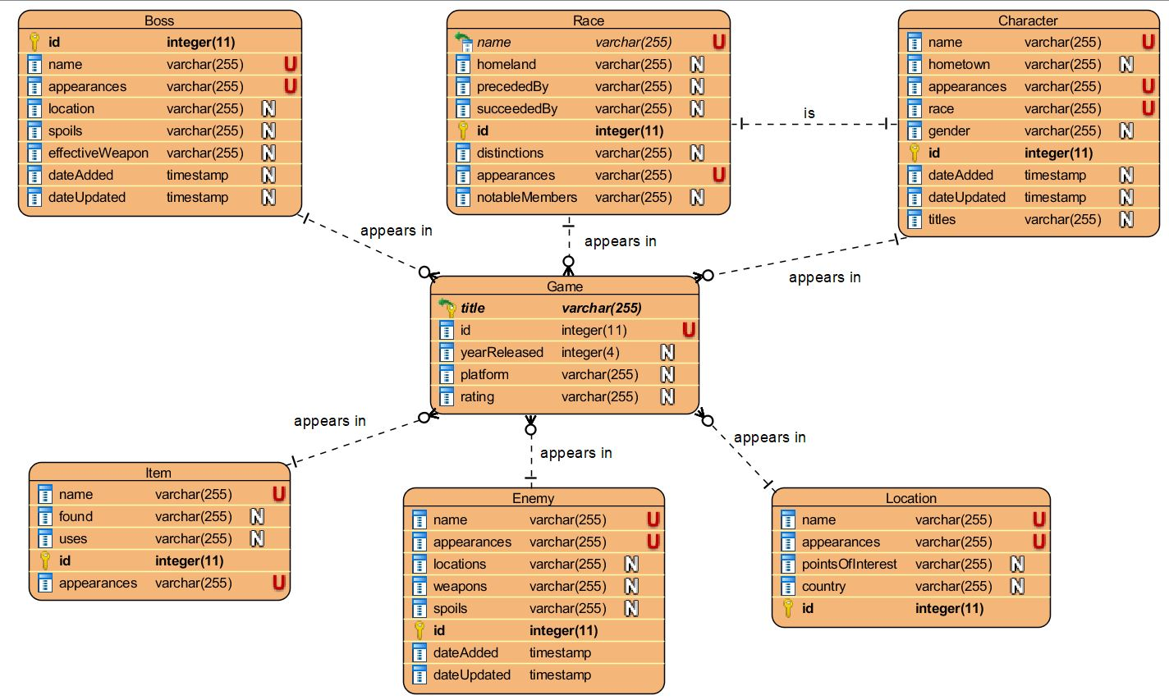
ER Diagram

Slide 4
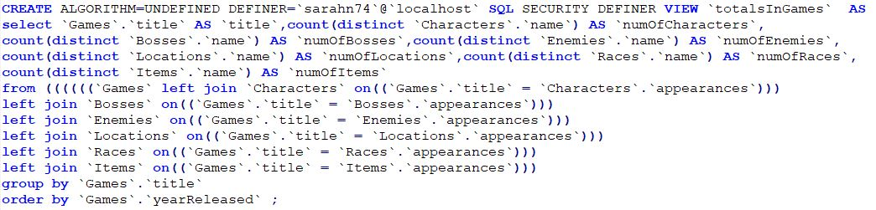
View

Slide 5
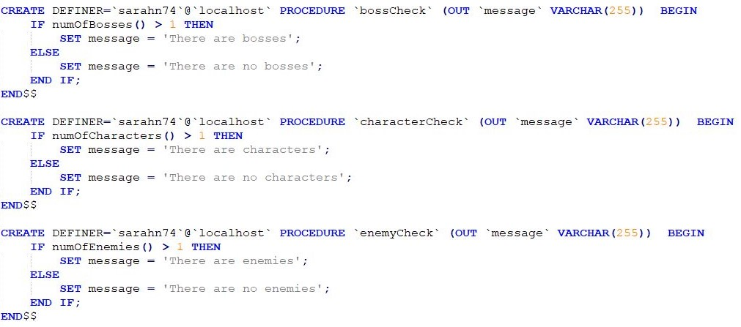
Procedures

Slide 6
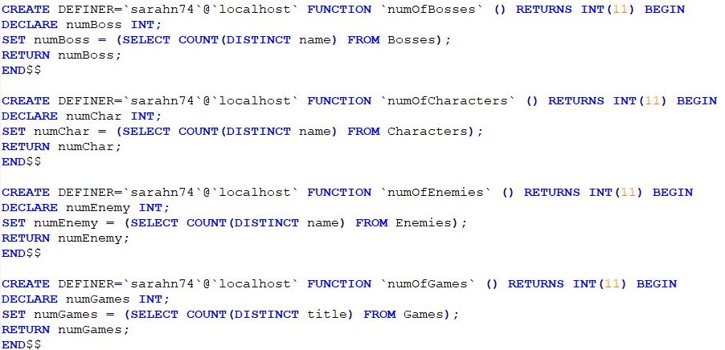
Functions

Slide 7
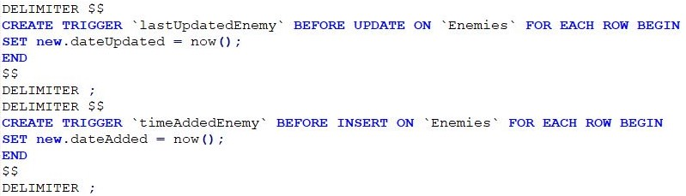
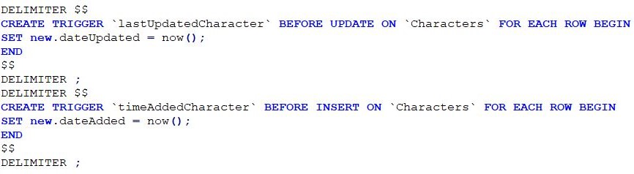
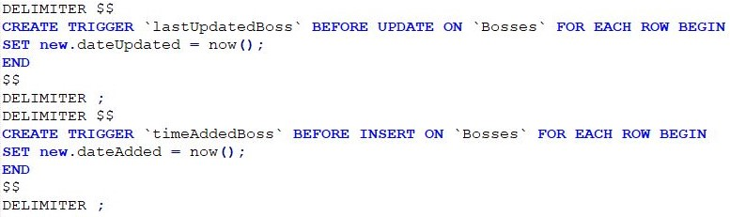
Triggers

Slide 8
Discussion
Normalization
3rd Normal Form - in 2NF and there exists no transitive functional dependencies
Integrity Enforcement
All IDs autoincrement
The appearances column of Characters, Bosses, Enemies, Locations, Races, and Items tables are Foreign Keys referencing the Titles in the Game table
The Race Column of Characters is a foreign key that references the name column in the Races table
Isolation Level
Repeatable Read - not making any transactions
Notes:
Isolation level - kept the default

Slide 9
http://sarahn.sgedu.site/CSCI332Project/listgames.php

